Slide 1

S. V. K. Sharon Surya
192324246
CSA1607 Data Warehousing And DataMining

Slide 2

DATA WAREHOUSING & BUSINESS INTELLIGENCE
Inside a Business Brain
How OLAP Turns Millions of Records into Smart Decisions
Imagine managing 500 supermarkets with millions of daily transactions. How do managers instantly discover which product sells best, in which city, during which season? OLAP is the intelligence engine behind those answers.

Slide 3

CHAPTER 1
What Is OLAP, Really?
Think of OLAP as Google Maps for business data — it lets you zoom in, pan out, and explore from any angle, instantly.
Raw Data
Data Warehouse
OLAP Engine
Business Decisions
OLAP (Online Analytical Processing) transforms raw historical data into multi-dimensional insights — in seconds, not hours.

Slide 4
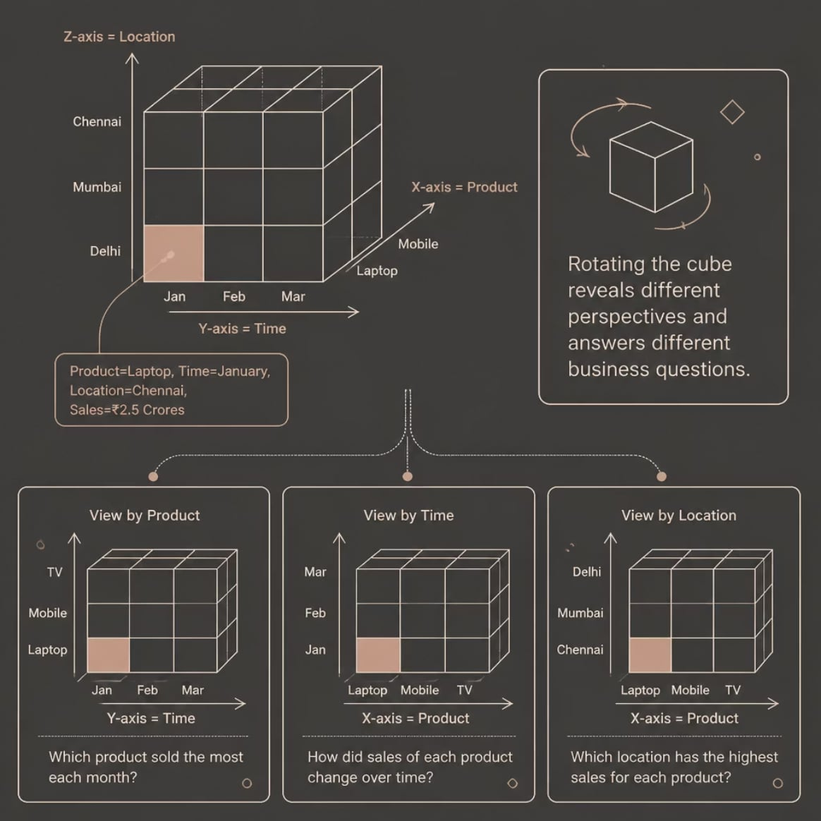

CHAPTER 2
The OLAP Data Cube
One Cube. Hundreds of Questions.
The same dataset answers completely different questions depending on your perspective:
Example: Laptop · January · Chennai = ₹2.5 Crores
By Product
By Time
By Location
Which laptop model sold most in Chennai this January?
Did sales peak in Q1 or Q4?
Which city generated the highest revenue?

Slide 5
CHAPTER 3
Four OLAP Operations
These four operations let analysts navigate the data cube with surgical precision — like controls on a business intelligence cockpit.
Slice
Dice
Dice
Isolate one dimension — e.g., show only Chennai data across all products and months.
Apply multiple filters — e.g., Laptops in Chennai during January–March.
Apply multiple filters — e.g., Laptops in Chennai during January–March.
Drill Down
Drill Down
Roll Up
Roll Up
Go deeper — Year → Month → Day. Uncover granular trends hidden in aggregates.
Go deeper — Year → Month → Day. Uncover granular trends hidden in aggregates.
Summarize upward — Day → Month → Year. Get the big-picture view instantly.
Summarize upward — Day → Month → Year. Get the big-picture view instantly.

Slide 6
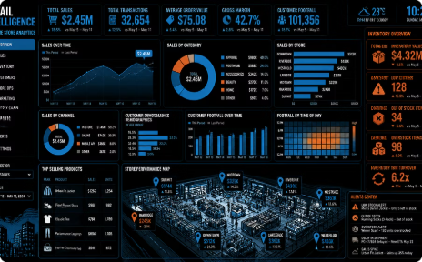
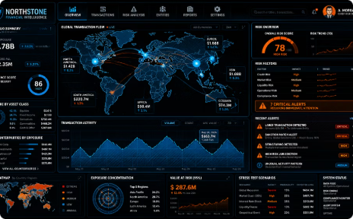
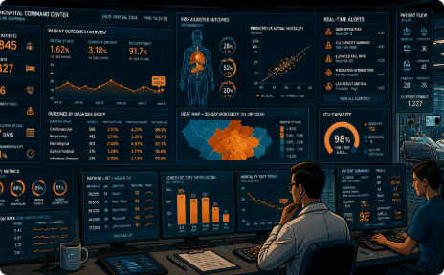
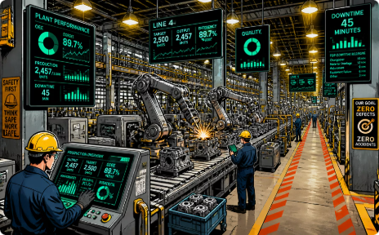
CHAPTER 4
OLAP in the Real World
From retail floors to hospital corridors, OLAP powers the dashboards that drive critical decisions every day.
Retail & E-Commerce
Banking & Finance
Healthcare
Manufacturing
Which products to restock? Which city leads revenue? OLAP answers in real time.
Track loan performance, detect fraud patterns, and analyze profitability by branch.
Monitor patient outcomes, optimize resource allocation, and predict seasonal demand.
Identify production bottlenecks, track supply chain efficiency, and forecast demand.

Slide 7
THE ROAD AHEAD
The Future of OLAP
OLAP is evolving — converging with AI, cloud platforms, and predictive models to power the next generation of intelligent systems.
AI & Machine Learning
Cloud Data Warehouses
Predictive Analytics
OLAP feeds clean, structured data into ML pipelines for smarter predictions.
Snowflake, BigQuery, and Redshift embed OLAP at massive scale.
From hindsight to foresight — OLAP powers proactive business intelligence.
"Data is the new oil. OLAP is the refinery that transforms it into intelligent decisions."
Thank you — Questions? 🙋

